Slide 1
Early Access to ART for All (EAAA) versus standard of care for access to antiretroviral therapy in HIV clients
Dr. Velephi Okello, Principal Investigator, MaxART Trial
Deputy Director, Clinical Services, Ministry of Health
July 25, 2018
International AIDS Conference
The MaxART stepped-wedge randomized controlled health systems trial in Eswatini

Slide 2
Background
The benefits derived from Early Access to ART for All (EAAA) have been demonstrated in previous trials.
Through this implementation trial, the Government of Eswatini wanted to:
Determine the clinical outcomes and evaluate the feasibility, affordability, and scalability of implementing a EAAA strategy in Eswatini’s government-managed health system
Understand the acceptability of a EAAA strategy among clients, health care workers, community members, and policymakers

Slide 3
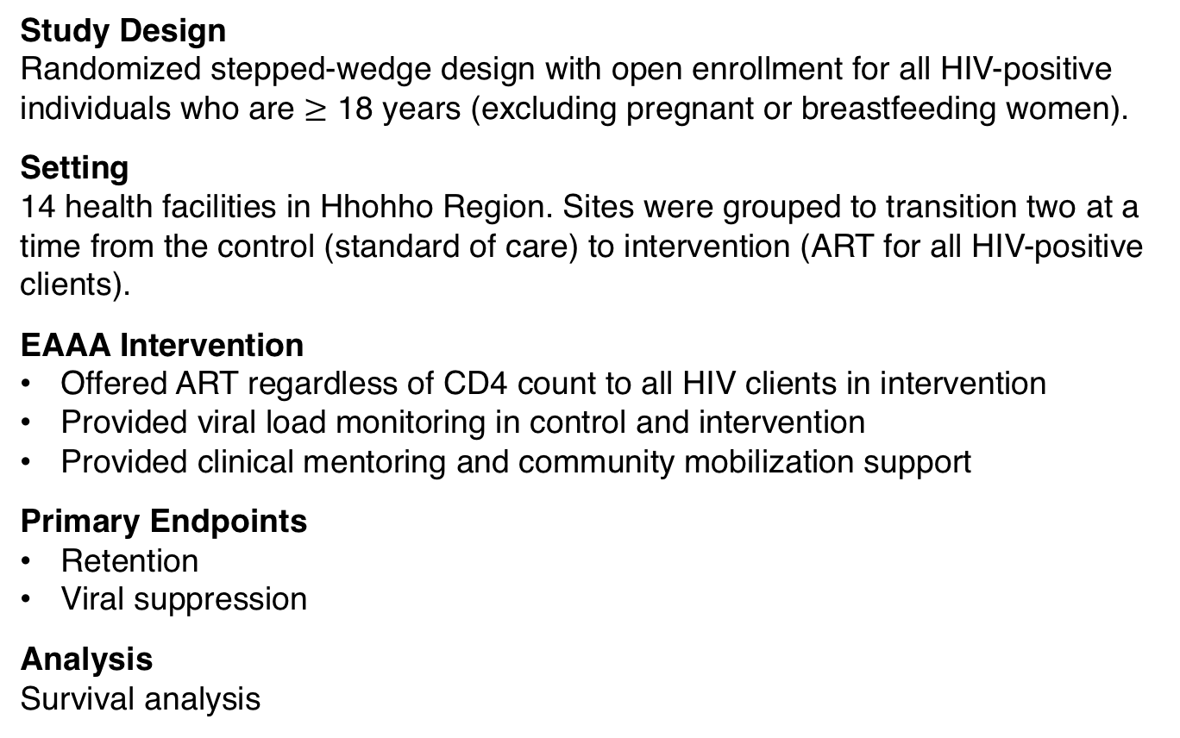
Methods
Study Design
Randomized stepped-wedge design with open enrollment for all HIV-positive individuals who are $≥$ 18 years (excluding pregnant or breastfeeding women).
Setting
14 health facilities in Hhohho Region. Sites were grouped to transition two at a time from the control (standard of care) to intervention (ART for all HIV-positive clients).
EAAA Intervention
Offered ART regardless of CD4 count to all HIV clients in intervention
Provided viral load monitoring in control and intervention
Provided clinical mentoring and community mobilization support
Primary Endpoints
Retention
Viral suppression
Analysis
Survival analysis

Slide 4
Stepped-Wedge Design 3405 eligible clients were enrolled between Sept 2014 - Aug 2017
Steps (4-month periods)
Group | Clinic | 1 | 2 | 3 | *4 | 5 | 6 | **7 | 8 | 9 | Total
1 | 1 | 67 | 58 | 34 | 14 | 20 | 20 | 13 | 15 | 4 | 245
 | 2 | 81 | 27 | 23 | 10 | 8 | 18 | 13 | 13 | 7 | 200
2 | 3 | 27 | 13 | 17 | 6 | 14 | 12 | 13 | 12 | 8 | 122
 | 4 | 37 | 12 | 56 | 14 | 19 | 16 | 8 | 5 | 5 | 172
3 | 5 | 27 | 13 | 10 | 13 | 14 | 9 | 15 | 5 | 1 | 107
 | 6 | 50 | 27 | 33 | 34 | 25 | 23 | 17 | 11 | 6 | 226
4 | 7 | 20 | 5 | 6 | 10 | 4 | 8 | 4 | 5 | 14 | 76
 | 8 | 163 | 87 | 83 | 116 | 109 | 78 | 43 | 57 | 62 | 798
5 | 9 | 93 | 45 | 30 | 17 | 22 | 18 | 6 | 19 | 22 | 272
 | 10 | 64 | 28 | 29 | 29 | 18 | 35 | 15 | 16 | 7 | 241
6 | 11 | 59 | 23 | 30 | 34 | 30 | 27 | 24 | 21 | 10 | 258
 | 12 | 54 | 16 | 34 | 20 | 9 | 26 | 23 | 16 | 13 | 211
7 | 13 | 16 | 18 | 18 | 22 | 12 | 7 | 17 | 6 | 4 | 120
 | 14 | 112 | 63 | 36 | 27 | 34 | 33 | 24 | 10 | 18 | 357
 | Total | 870 | 435 | 439 | 366 | 338 | 330 | 235 | 211 | 181 | 3405
*Swaziland ART guidelines for ART initiation changed from a CD4 count threshold of ≤350 cells/μl to ≤500 cells/µl on December 1, 2015.
** Swaziland’s national ART guidelines for ART initiation changed a CD4 count threshold of ≤500 cells/μl or less to a universal test and treat approach on October 1, 2016.

Slide 5
Baseline Study Population 2034 (60%) of clients enrolled during the Standard of Care phase
and 1371 (40%) during EAAA phase
 | Standard of Care (n=2034) | EAAA (n=1371) | All ART naïve (n=3405)
Age group (years) n (%)
18 – <20 | 40 (2%) | 34 (2%) | 74 (2%)
20 – <30 | 679 (33%) | 472 (34%) | 1151 (34%)
30 – <40 | 722 (35%) | 500 (36%) | 1222 (36%)
40 – <50 | 354 (17%) | 230 (17%) | 584 (17%)
50 – <60 | 156 (8%) | 97 (7%) | 253 (7%)
60+ | 83 (4%) | 38 (3%) | 121 (4%)
Sex n(%)
Male | 695 (34%) | 603 (44%) | 1298 (38%)
Female | 1339 (66%) | 768 (56%) | 2107 (62%)
Marital Status n(%)
Married | 1045 (52%) | 634 (48%) | 1679 (51%)
Divorced/Widowed | 127 (6%) | 78 (6%) | 205 (6%)
Single | 825 (41%) | 614 (46%) | 1439 (43%)
Education n(%)
Illiterate/Primary | 589 (40%) | 384 (38%) | 973 (39%)
Secondary | 438 (30%) | 362 (36%) | 800 (32%)
High School | 401 (27%) | 218 (22%) | 619 (25%)
Tertiary | 48 (3%) | 37 (4%) | 85 (3%)
Basic characteristics at the time of trial enrollment

Slide 6
Baseline Study Population 79% of clients enrolling under EAAA were diagnosed less than a year compared to 59% under Standard of Care
 | Standard of Care (n=2034) | EAAA (n=1371) | All ART naïve (n=3405)
CD4 (cells/µl) n(%)
<350 | 804 (44%) | 632 (56%) | 1436 (49%)
350 – 500 | 441 (24%) | 224 (20%) | 665 (22%)
>500 | 591 (32%) | 266 (24%) | 857 (29%)
CD4 missing n(%) | 198 (10%) | 249 (18%) | 447 (13%)
WHO stage n(%)
1 | 1074 (63%) | 800 (63%) | 1874 (63%)
2 | 357 (21%) | 320 (25%) | 677 (23%)
3 or 4 | 264 (16%) | 146 (12%) | 410 (14%)
WHO stage missing n(%) | 339 (17%) | 105 (8%) | 444 (13%)
Baseline Viral load (copies/ml) n(%)
<1000 | 229 (12%) | 120 (10%) | 349 (11%)
1000 - <50‚000 | 781 (41%) | 479 (40%) | 1260 (41%)
50‚000 - <100‚000 | 213 (11%) | 150 (13%) | 363 (12%)
≥100‚000 | 661 (35%) | 438 (37%) | 1099 (36%)
Baseline Viral load missing n(%) | 150 (7%) | 184 (13%) | 334 (10%)
Time between positive HIV test to trial enrollment (years) n(%)
≤1 | 1189 (59%) | 1076 (79%) | 2265 (67%)
1 - ≤3 | 421 (21%) | 134 (10%) | 555 (16%)
>3 | 413 (20%) | 144 (11%) | 557 (16%)
Clinical characteristics at the time of trial enrollment

Slide 7
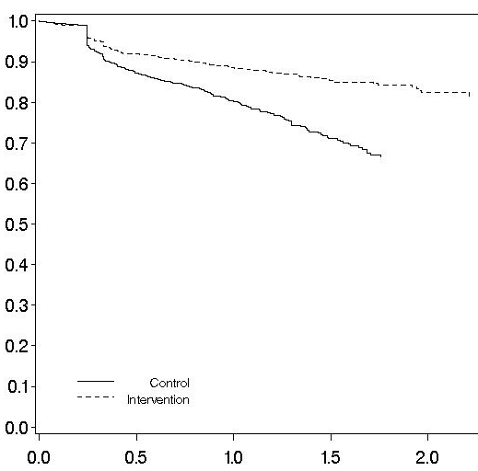
Retention 60% increase in retention under EAAA compared to Standard of Care
Retention rates among all clients (2874/3405)
Intervention
Control
Retained
HR: 1.60 (95% CI: 1.15-2.21)
p=0.005
Years since study enrolment
*All clients: All enrolled pre-ART and ART clients

Slide 8
Retention
86% retention rate under EAAA compared to 80% under Standard
of Care at 12 months
Retention rates among all clients (2874/3405)
Intervention
12 month rates: 86% (95% CI: 83,88)
Control
12 month rates: 80% (95% CI: 77,83)
Retained
HR: 1.60 (95% CI: 1.15-2.21)
p=0.005
Years since study enrolment
*All clients: All enrolled pre-ART and ART clients

Slide 9
Economic Evaluation
EAAA does not affect per-patient ART delivery costs
Total
ARVs
Personnel
Labs

Slide 10
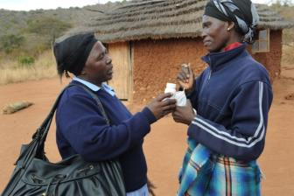
Summary
The observed improvement in retention, a key indicators of ART success, provides an important co-benefit of EAAA
Improved retention did not increase costs per ART patient per year
Analyses of further trial results are ongoing

Slide 11
Want to Learn More? Other MaxART presentations at AIDS 2018
Satellite Session | Wednesday 25 July 18:30-20:30 Room E102 | Overall Results of the MaxART Early Access to ART for All implementation study: Clinical Findings Cost analysis Role of communities and community leaders Social science research: the role of context Implementing Test & Start in Swaziland – Hon. Minister of Health Eswatini
Oral Poster Discussion | Thursday 26 July 13:00 - 14:00 Room E102 | Empirical cost of community mobilization activities to support the scale-up of Universal Test and Treat in Swaziland
Poster Exhibition | Tuesday 12.30-14.30 | Casual costing analysis of Test & Treat for ART clients
 | Wednesday 12.30-14.30 | Impact of a “test and treat” on retention in a public sector health system setting
 | Wednesday 12.30-14.30 | Impact of viral load demand creation on viral load monitoring in Swaziland
 | Wednesday 12.30-14.30 | Traditional leaders play a key role in the roll out of early ART at community level
 | Thursday 12.30-14.30 | Time to antiretroviral therapy initiation under Early Access to ART for All
 | Thursday 12.30-14.30 | Changes in disclosure, adherence and patient experiences of communication following the ‘Early access to ART for all’ intervention in Swaziland

Slide 12
Thank You

